Slide 1
Coptic Lesson 18 PAST Tense

Slide 2
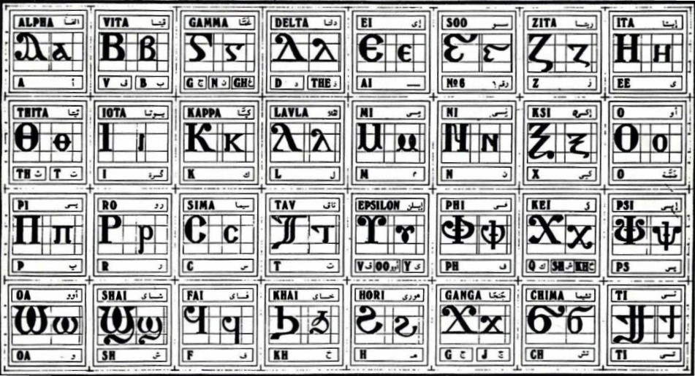
Coptic Alphabets

Slide 3
Review Questions
Coptic
Name
English
b
Veeta
b, v
[
Cheema
ch
¢
marteroc
Martyr
=p=y
qamne-`smyn
88
=f^
pictau-coou
96
} ]
Tee
ti
=t=i=y
Somt-se-myt-`smyn
318

Slide 4
Review for Beginners
Coptic
Name
English
[
Cheema
ch
p
Pei
p
v
Phei
ph
r
Ro
r
q
Khai
kh
l
Lavla
L
d
Delta
d, z

Slide 5
Rule for the Kei <:
k
(in a Coptic Word)
< , =
sh
(Gk, before the e-family)
e-family:
e> y> i> u
kh
(Gk, otherwise)
Examples:
,ymi
,aric
,ere
`,rwm
Ar,y
Mona,oc
,w
Lu,nia
Pi,iwn
,wra
Ic,uroc

Slide 6
Vocabulary List
nah]
to believe
]
to give
,w
to put
[i
to take
sini
to ask
]`cbw
to teach

Slide 7
Coptic Bible Verses – Part 3
Rasi qen `P[oic `ncyou niben Rejoice in the Lord always. (Phil 4:4)
Twbh `ejen neten`eryou Pray for one another. (Jm 5:16)
Vnou] ouagapy pe God is love. (I Jn 4:16)
Jemnom] anok ai[ro `epikocmoc Be of good cheer, I have overcome the world. (Jn 16:33)
}ar,y `n]covia ]ho] `nte `P[oic te The fear of the Lord is the beginning of wisdom. (Ps 110:10)

Slide 8
Beginner Vocabulary Review
romi kahi `Vnou] `alou ioh
ry con syri iwt bal
yi ran ro ouro nyb
`chimi vorsi seri ourw ri
cwni ajp ve sau soury
mau ]`alou jij `;nyb hiomi
nicwni nirwmi niran nimau ni`alou
jom niourw nibal nisau ninyb
niseri totc io] ourwou vyou`i

Slide 9
Simple PASt Tense
ainah]
aknah]
arenah]
afnah]
acnah]
annah]
aretennah]
aunah]
I believed
you believed (masculine)
you believed (feminine)
he believed
she believed
we believed
you believed (plural)
they believed

Slide 10
Exercise (Part 1)
Use the following verbs to form a past tense:
nau
to look
menre
to like
caji
to speak
ws
to read
hemci
to sit
cw
to drink
[i
to take
,w
to put

Slide 11
Exercise (Part 2)
Translate the following into English:
ainau `epekcon
I saw your brother.
anjerjer qen pi[wm
We played in the garden.
au`i `nje nek`cnyou
Your brothers came.
aicaji nemaf
I spoke with him.
au`slyl qen ]`ekklyci`a
They prayed in the church.
Af`i `nje P=,=c `ebolqen `tve
Christ came from heaven.
aftwnf `ebolqen nye;mwout
He arose from the dead.
af,w `nnefjwm hijen ]vorsi
He put his books on the table.

Slide 12
Announcement
All slides are available at http://www.ekladious.com/coptic.html

Slide 13
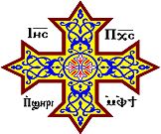
Oujai qen `P[oic

